Slide 1
Cache Design
Size
Mapping Function
Replacement Algorithm
Write Policy
Block Size
Number of Caches

Slide 2
Size does matter
Cost
  More cache is expensive
Speed
  More cache is faster (up to a point)
  Checking cache for data takes time

Slide 3

Typical Cache Organization

Slide 4
Mapping Function
Because there are fewer cache lines than main memory blocks, an algorithm is needed for mapping the main memory blocks into cache line.
Three techniques can be used: Direct mapping, Associative mapping, Set associative mapping
For all three techniques, we have (assume)
  Cache of 64KBytes
  Data is transferred between main memory and the cache in blocks of 4 bytes each. Thus, the cache is organized as 16K=(2¹⁴) lines of 4 bytes each
  16MB of main memory, with each byte directly addressable by a 24-bit address, since 2²⁴=16MB
  Thus, for mapping purposes, the main memory consists of 4M blocks of 4 bytes each

Slide 5
Direct Mapping
Each block of main memory maps to only one cache line
  i.e. if a block is in cache, it must be in one specific place
Address is in two parts
Least Significant w bits identify unique word
Most Significant s bits specify one memory block
The MSBs are split into a cache line field r and a tag of s-r (most significant)
i = j modulo m
Where
i = cache line number
j = main memory block number
m = number of lies in the cache

Slide 6
Direct Mapping
Address Structure
Tag s-r
Line or Slot r
Word w
8
14
2
24 bit address
2 bit word identifier (4 byte block)
22 bit block identifier
  8 bit tag (=22-14)
  14 bit slot or line
No two blocks that map into the same line have the same Tag field
The 14 bit nine number is used as an index into the cache to access a particular line.
If the 8-bit tag number matches the tag number currently stored in that line then 2-bit word number is used to select one of the four bytes in that line
Otherwise 22-bit tag-plus-line field is used to fetch a block from main memory

Slide 7
Direct Mapping
Cache Line Table
Cache line Main Memory blocks held
0 0, m, 2m, 3m…2^{s}-m
1 1,m+1, 2m+1…2^{s}-m+1
m-1 m-1, 2m-1,3m-1…2^{s}-1

Slide 8
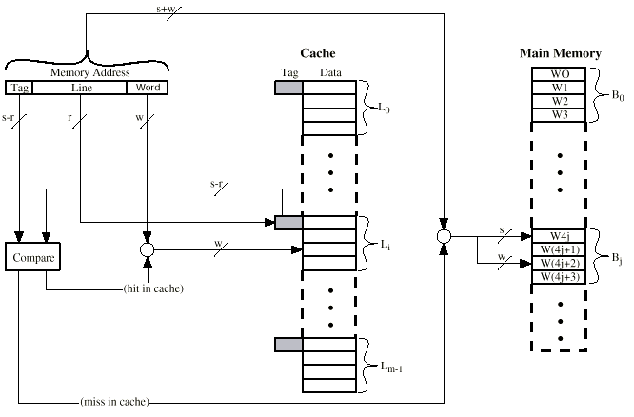
Direct Mapping Cache Organization

Slide 9
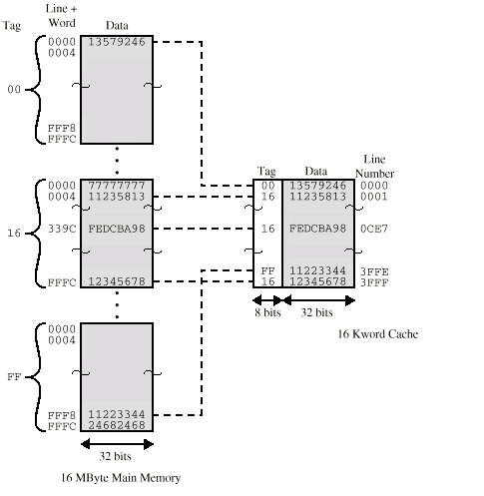
Direct Mapping Example

Slide 10
Direct Mapping Summary
Address length = (s + w) bits
Number of addressable units = 2^{s+w} words or bytes
Block size = line size = 2^{w} words or bytes
Number of blocks in main memory = 2^{s+ w}/2^{w} = 2^{s}
Number of lines in cache = m = 2^{r}
Size of tag = (s – r) bits

Slide 11
Direct Mapping pros & cons
Simple
Inexpensive
Fixed cache location for given block
  If a program accesses 2 different blocks that map to the same line, then the blocks will be continually swapped in the cache, and the hit ratio will be low (cache misses are very high)

Slide 12
Associative Mapping
A main memory block can load into any line of cache
Memory address is interpreted as tag and word
Tag uniquely identifies block of memory
To determine whether a block is in the cache, the cache control logic must simultaneously examine every line’s tag is examined for a match
Disadvantage: complex circuits required to examine the tags of all cache lines in parallel

Slide 13
Associative Mapping
Address Structure
Word
2 bit
Tag 22 bit
22-bit tag stored with each 32-bit block of data for each line in the cache
Compare tag field of address with tag entry in cache to check for hit
e.g.
  Address Binary Data
  16339C 0001 0110 0011 0011 1001 1100 24682468 tag(leftmost 22bits) 00 0101 1000 1100 1110 0111
        ( Hex 0 5 8 C E 7 )

Slide 14

Fully Associative Cache Organization

Slide 15
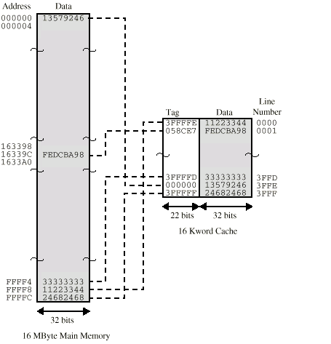
Associative Mapping Example

Slide 16
Associative Mapping Summary
Address length = (s + w) bits
Number of addressable units = 2^{s+w} words or bytes
Block size = line size = 2^{w} words or bytes
Number of blocks in main memory = 2^{s+ w}/2^{w} = 2^{s}
Number of lines in cache = undetermined
Size of tag = s bits

Slide 17
Set Associative Mapping
Cache is divided into a number of sets
Each set contains a number of lines
A given block maps to any line in a given set
  e.g. Block B can be in any line of set i
e.g. 2 lines per set
  2 way associative mapping
  A given block can be in one of 2 lines in only one set

Slide 18
Set Associative Mapping
Example
13 bit set number
Block number in main memory is modulo 2¹³
000000, 00A000, 00B000, 00C000 … map to same set

Slide 19
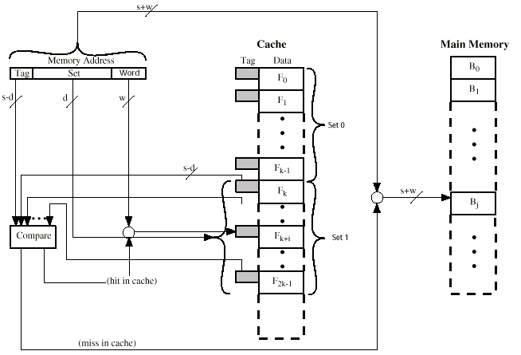
Two Way Set Associative Cache Organization

Slide 20
Set Associative Mapping
Address Structure
Word
2 bit
Tag 9 bit
Set 13 bit
Use set field to determine cache set to look in
Compare tag field to see if we have a hit
e.g
  Address Tag Data Set number
  1FF 7FFC 1FF 12345678 1FFF
  001 7FFC 001 11223344 1FFF

Slide 21
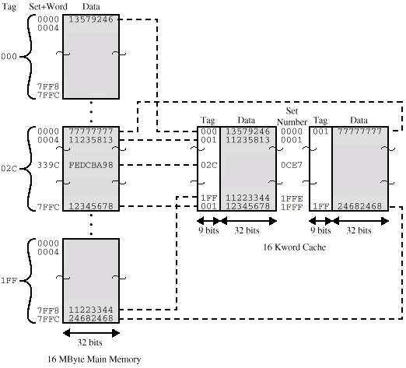
Two Way Set Associative Mapping Example

Slide 22
Set Associative Mapping Summary
Address length = (s + w) bits
Number of addressable units = 2^{s+w} words or bytes
Block size = line size = 2^{w} words or bytes
Number of blocks in main memory = 2^{d}
Number of lines in set = k
Number of sets = v = 2^{d}
Number of lines in cache = kv = k * 2^{d}
Size of tag = (s – d) bits

Slide 23
Replacement Algorithms (1)
Direct mapping
No choice
Each block only maps to one line
Replace that line

Slide 24
Replacement Algorithms (2)
Associative & Set Associative
Hardware implemented algorithm (speed)
Least Recently used (LRU)
e.g. in 2 way set associative
  Which of the 2 block is least recently used?
First in first out (FIFO)
  replace block that has been in cache longest
Least frequently used
  replace block which has had fewest hits
Random

Slide 25
Write Policy
Must not overwrite a cache block unless main memory is up to date
Multiple CPUs may have individual caches
I/O may address main memory directly

Slide 26
Write through
All writes go to main memory as well as cache
Multiple CPUs can monitor main memory traffic to keep local (to CPU) cache up to date
Lots of traffic
Slows down writes
Remember bogus write through caches!

Slide 27
Write back
Updates initially made in cache only
Update bit for cache slot is set when update occurs
If block is to be replaced, write to main memory only if update bit is set
Other caches get out of sync
I/O must access main memory through cache
N.B. 15% of memory references are writes

Slide 28
Pentium 4 Cache
80386 – no on chip cache
80486 – 8k using 16 byte lines and four way set associative organization
Pentium (all versions) – two on chip L1 caches
  Data & instructions
Pentium 4 – L1 caches
  8k bytes
  64 byte lines
  four way set associative
L2 cache
  Feeding both L1 caches
  256k
  128 byte lines
  8 way set associative

Slide 29
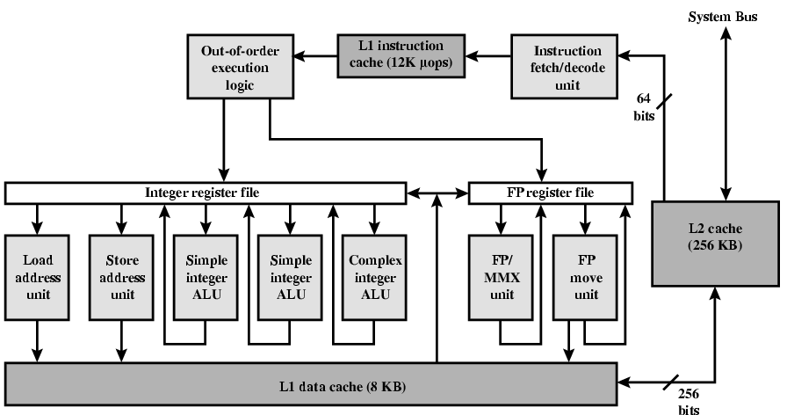
Pentium 4 Diagram (Simplified)

Slide 30
Pentium 4 Core Processor
Fetch/Decode Unit
  Fetches instructions from L2 cache
  Decode into micro-ops
  Store micro-ops in L1 cache
Out of order execution logic
  Schedules micro-ops
  Based on data dependence and resources
  May speculatively execute
Execution units
  Execute micro-ops
  Data from L1 cache
  Results in registers
Memory subsystem
  L2 cache and systems bus

Slide 31
Pentium 4 Design Reasoning
Decodes instructions into RISC like micro-ops before L1 cache
Micro-ops fixed length
  Superscalar pipelining and scheduling
Pentium instructions long & complex
Performance improved by separating decoding from scheduling & pipelining
  (More later – ch14)
Data cache is write back
  Can be configured to write through
L1 cache controlled by 2 bits in register
  CD = cache disable
  NW = not write through
  2 instructions to invalidate (flush) cache and write back then invalidate

Slide 32
Power PC Cache Organization
601 – single 32kb 8 way set associative
603 – 16kb (2 x 8kb) two way set associative
604 – 32kb
610 – 64kb
G3 & G4
  64kb L1 cache
    8 way set associative
  256k, 512k or 1M L2 cache
    two way set associative

Slide 33
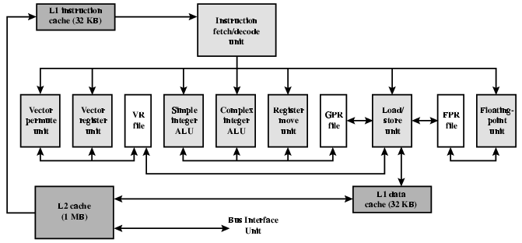
PowerPC G4

Slide 34
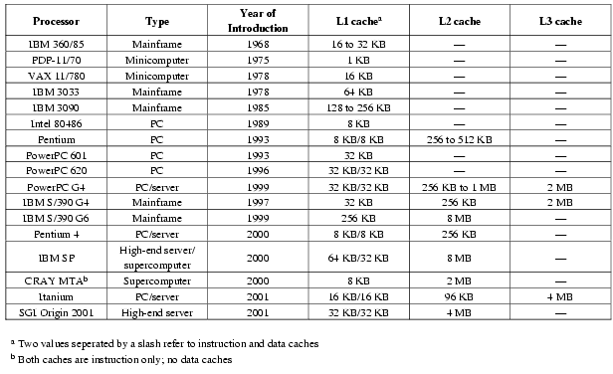
Comparison of Cache Sizes

